Slide 1
GENERAL ASSEMBLY
European Policy
The EU Green Deal and land management
Thierry de l’Escaille, Secretary General
France, 1st December 2021

Slide 2
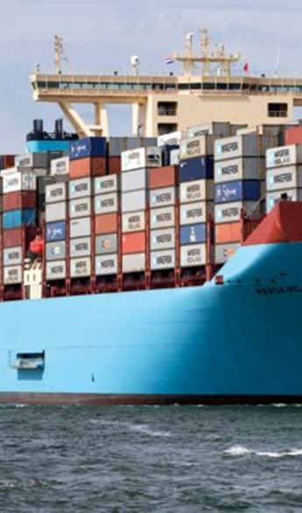
A post pandemic world?
Stress in global trade markets due to economic recovery, scarcity in raw materials and high energy prices
US-China tensions are not abiding, despite the new administration and in Russia : migration, and energy prices risk destabilising beyond its borders
Brexit is now a reality, and the European project and the legitimacy of its institutions is questioned elsewhere in Europe. When the pandemic hit, borders were back, even within Schengen.

Slide 3
Growing polarisation
30% of European Parliament now in the hands of left and right populists
The rise of social media is feeding an ever growing polarization
French elections campaign is seeing right and left populists gain traction, and Germany is entering an unknown post-Merkel era
Government debts is reaching incredible heights with pandemic support packages, budgetary austerity is a thing of the past

Slide 4
Climate change
Cop 26 and EU “leading by example”: truth or dare ?
Last four years were the warmest years ever recorded
More extreme weather events (droughts, floods, hurricanes etc.)
Shift in seasons causing effects in global agricultural production and ecosystems
Changes in weather patterns bring new diseases, pests and diseases

Slide 5
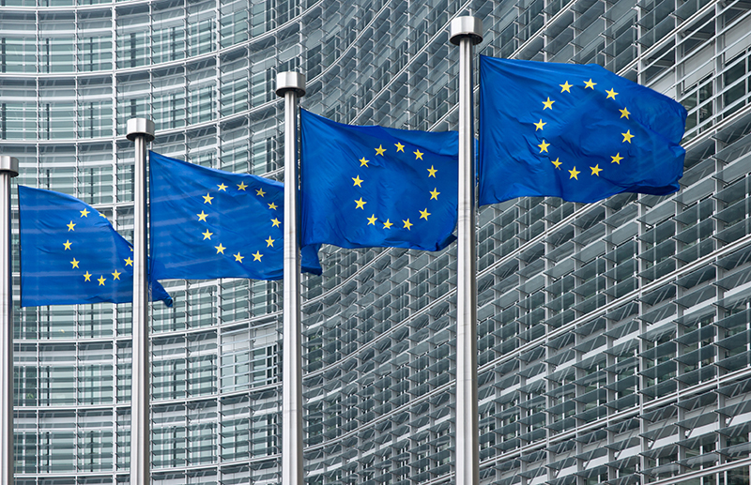
GENERAL ASSEMBLY
EU priorities
& policies

Slide 6
CLIMATE
PACT AND CLIMATE
LAW
PROMOTING
CLEAN
ENERGY
INVESTING IN
SMARTER, MORE
SUSTAINABLE
TRANSPORT
PROTECTING NATURE
STRIVING
FOR GREENER
INDUSTRY
The European
Green Deal
FROM FARM
TO FORK
ELIMINATING
POLLUTION
ENSURING
A JUST TRANSITION
FOR ALL
LEADING THE
GREEN CHANGE
GLOBALLY
MAKING
HOMES ENERGY EFFICIENT
FINANCING
GREEN
PROJECTS

Slide 7
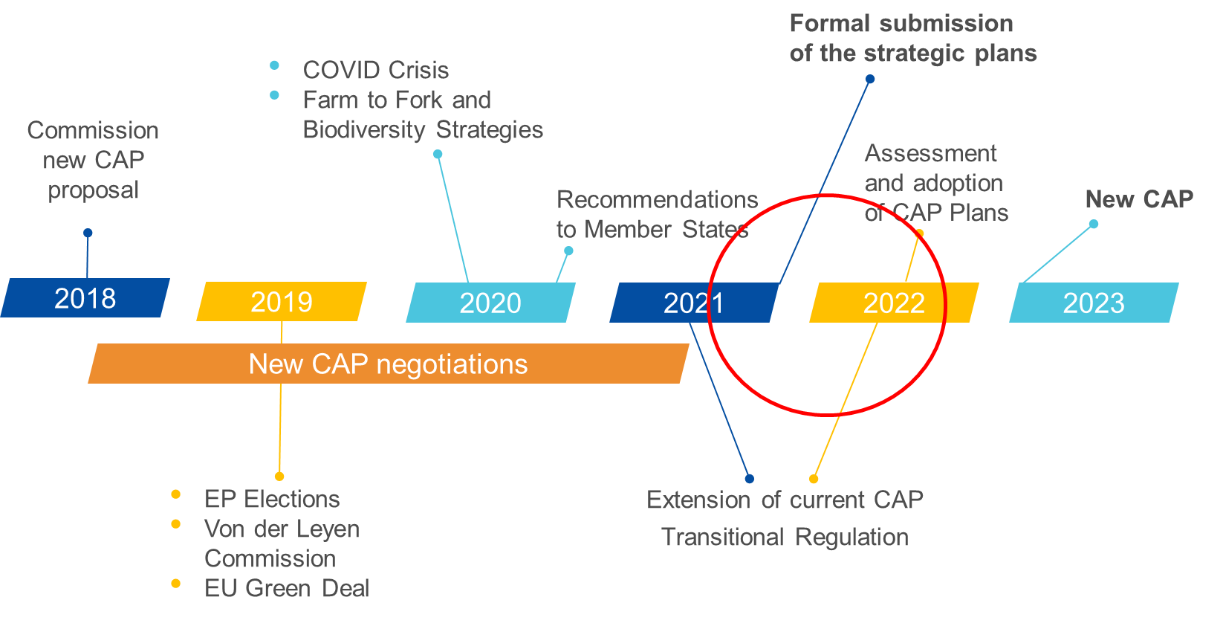
CAP reform: Timeline

Slide 8
CAP reform: Timeline
Basic acts
23/11/21: EP plenary vote
02/12/21: Council adoption
02/12/21: Signature
06/12/21: Publication
7/12/21: Entry into force
Key delegated acts
23/11/21: Meeting of Expert group
07/12/21: Adoption
09/12/21: COMAGRI meeting for decision «early non-objection»
TBD: SCA on «early non-objection»
16/12/21: EP plenary for decision on “non-objection”
TBC: Publication (last OJ of December)
Key implementing acts
9-13/12/21:Committee written vote
21/12/21: Adoption
TBC: Publication (last OJ in December)
Entry into force

Slide 9
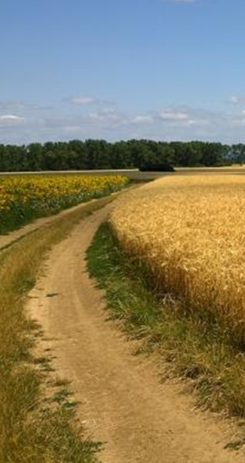
CAP reform: Delegated &
Implementing acts
Acts to be adopted by end 2021:
DA and IA: Types of interventions (more details on Art65 on Animal welfare, for example)
IA: Content of CAP Plan
IA: Indicators calculation method
DA and IA: Governance bodies, financial management, performance clearance and common provisions

Slide 10
CAP reform: Delegated &
Implementing acts
IA on the CAP Plan content:
•Strategic statement
•Assessment of needs, intervention strategy, context indicators and target plan
•Consistency of the strategy
•Elements common to several interventions
•Description of the interventions
•Financial plan
•Governance system and coordination
•Modernisation
•Annexes
Discussed with MS experts on 5/10,18/10 and 23/11

Slide 11
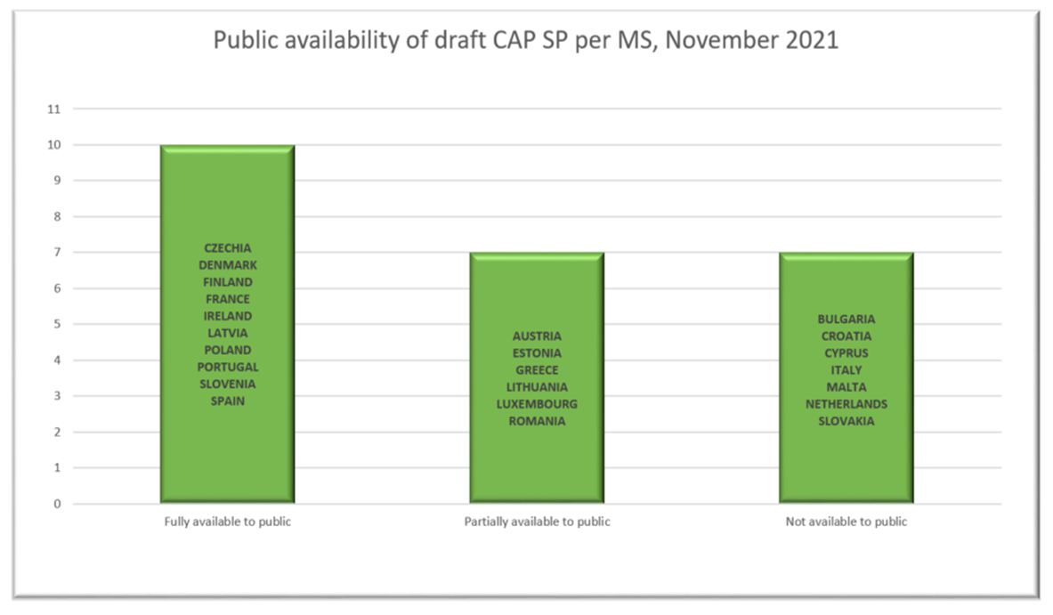
CAP reform: Status of the Strategic Plans
(This is based on information available to the Commission)

Slide 12
CAP reform Transition
2020
2021
2022
2023
2024
2025
Without transition
RDPs 2014-2020
N+3 PERIOD
With a 2-year transition
Extended RDPs 2014- 2022
N+3 PERIOD
CAP STRATEGIC PLANS 2023-2027

Slide 13
Farm to Fork
Transforming the EU’s economy for a sustainable future
Increasing the EU’s Climate ambition for 2030 and 2050
A zero pollution ambition
for a toxic-free environment
Supplying clean, affordable and secure energy
Preserving and restoring ecosystems and biodiversity
The
European Green Deal
Mobilising industry
for a clean and circular economy
From ‘Farm to Fork’: a fair, healthy and environmentally friendly food system
Building and renovating in an energy and resource efficient way
And leaving
no one behind
Accelerating the shift to sustainable and smart mobility
Designing a set of
deeply transformative policies

Slide 14
Farm to Fork
Proposes targets for sustainable food production for 2030:
Reduce by 50% the overall use and risk of chemical pesticides and reduce use by 50% of more hazardous pesticides
→ Evaluation of and consultation on the Sustainable Use of Pesticides (legislative proposals by early 2022)
Reduce nutrient losses by at least 50% while ensuring no deterioration in soil fertility; this will reduce use of fertilisers by at least 20 %
Reduce sales of antimicrobials for farmed animals and in aquaculture by 50%
Achieve at least 25% of the EU’s agricultural land under organic farming
→ Adoption of an EU Action Plan for organic farming to boost demand for organics products

Slide 15
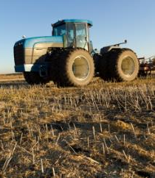
Farm to Fork
Main concerns:
Lack of available alternative crop protection methods on the market,
Lack of reference to the socio-economic shift the conversion to organic farming will cause.
Lack of scientific motivation
Findings of several impact studies that have shown that European agriculture will be highly impacted

Slide 16
Farm to Fork
According to recent studies (JRC, USDA, COCERAL, Kiel University, Wageningen University), it was found that by 2030:
There will be a decline in overall EU agricultural production and an increase in the third countries output volumes, especially in the case where Europe would be the only one to embrace this philosophy.
International markets will be affected, with export capacity going significantly down, while the level of imports would increase.
Food prices will increase, against the background of supply shortages, while farmers’ income will be negatively affected
The positive climate impacts may be limited, as about 50% of the gains obtained in Europe will be offset by emissions’ transfers to third countries through increased import of food no longer produced in Europe

Slide 17
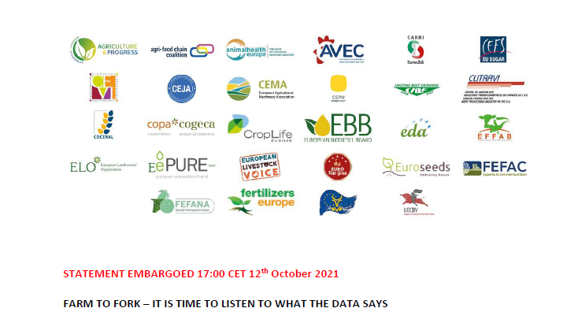
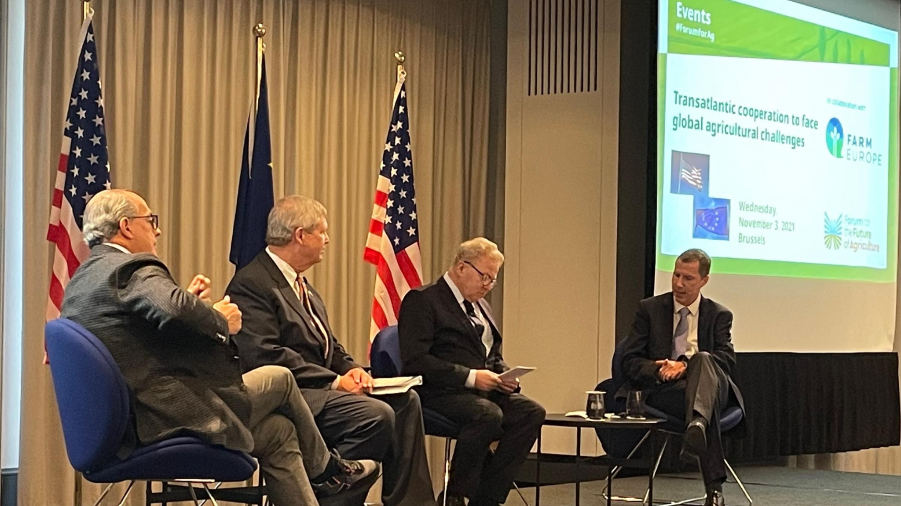
Farm to Fork
ELO actions:
Joint position on F2F (on our website): together with the main European organisations, we called for a comprehensive assessment because we want to understand where problems are likely to arise, so that we can discuss the potential solutions.
EU-US event: high level event for the launch of a transatlantic collaboration platform on agriculture designed to take on the global challenges of sustainability and climate change
Workshop on trade that explored how the EU Green Deal and its environmental standards will affect the international food sector and livelihoods of farmers in vulnerable rural areas of export nations

Slide 18
Biodiversity Strategy 2030
Transforming the EU’s economy for a sustainable future
Increasing the EU’s Climate ambition for 2030 and 2050
A zero pollution ambition
for a toxic-free environment
The
European Green Deal
Supplying clean, affordable and secure energy
Preserving and restoring ecosystems and biodiversity
Mobilising industry
for a clean and circular economy
From ‘Farm to Fork’: a fair, healthy and environmentally friendly food system
Building and renovating in an energy and resource efficient way
And leaving
no one behind
Accelerating the shift to sustainable and smart mobility
Designing a set of
deeply transformative policies

Slide 19
Biodiversity Strategy 2030
Protect 30% of the EU’s land area, with 10% strictly protected. Based on Natura 2000 and nationally designated areas and integrating ecological corridors
EU Restoration Plan with 2030 commitments to include: new legally binding targets (2021); the targets repeated in the F2F, reverse the decline in pollinators, remediate contaminated soils sites, IAS...
30% of species and habitats which are not in favourable status will achieve such status by 2030
Landscape features and rotational and non rotational set aside in 10% of the agricultural area
important implications for EU forests & forestry
Main concerns: Strict protection + New binding nature restoration target + lack of funding (no mention of payments for ecosystems services), lack of recognition of private conservation, lack of feasibility study…

Slide 20
Biodiversity Strategy 2030
ELO is participating in:
Nature Directors Meeting (linked with the council presidency)
Coordination Group for Biodiversity and Nature (CGBN)
Sub Group on the Birds and Habitats Directives (NADEG)
Sub Group on the Mapping and Assessment of Ecosystems and their Services (MAES)
Working Group Invasive Alien Species
Working Group Forest & Nature
Working Group Nature Restoration
Biogeographical seminars (under revision)
Natura 2000 User's forum

Slide 21
Biodiversity Strategy & forests
Biodiversity Strategy for 2030
Increase protection (legal binding targets for restoration) and strict protection (including all primary and old-growth forests);
Planting at least 3 billion trees by 2030 in full respect of ecological principles (including in urban areas and agriculture);
Guidelines on afforestation and reforestation and close-to-nature-forestry practices
Discussions led by DG ENV (Working group on forest & nature)

Slide 22
Fit for 55
Transforming the EU’s economy for a sustainable future
Increasing the EU’s Climate ambition for 2030 and 2050
A zero pollution ambition
for a toxic-free environment
The
European Green Deal
Supplying clean, affordable and secure energy
Preserving and restoring ecosystems and biodiversity
Mobilising industry
for a clean and circular economy
From ‘Farm to Fork’: a fair, healthy and environmentally friendly food system
Building and renovating in an energy and resource efficient way
And leaving
no one behind
Accelerating the shift to sustainable and smart mobility
Designing a set of
deeply transformative policies

Slide 23
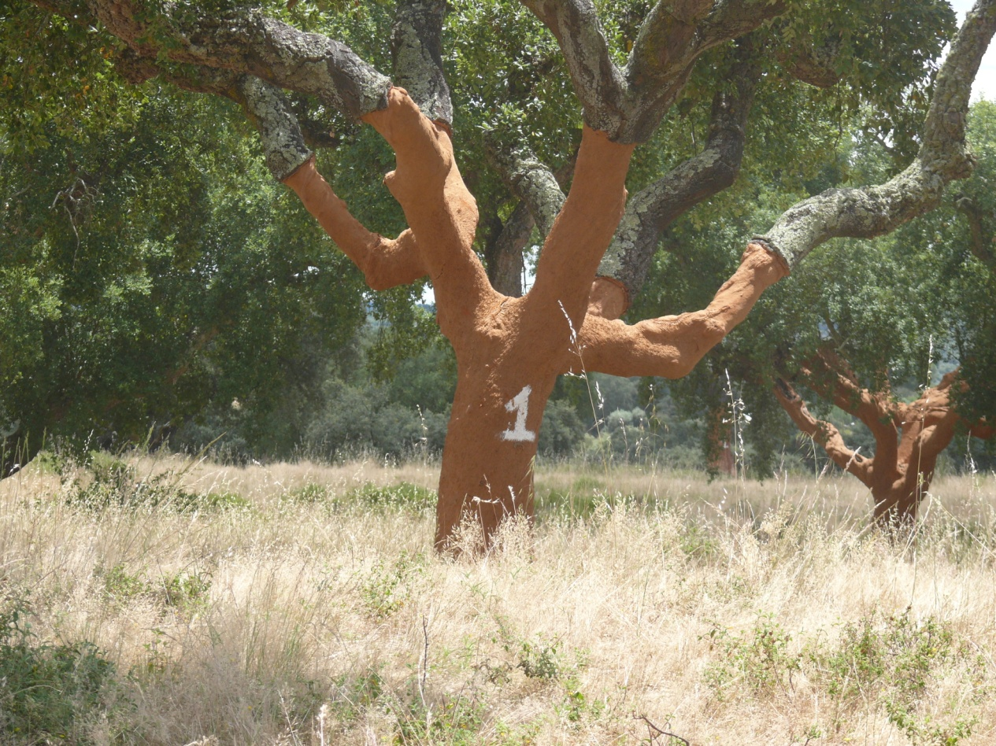
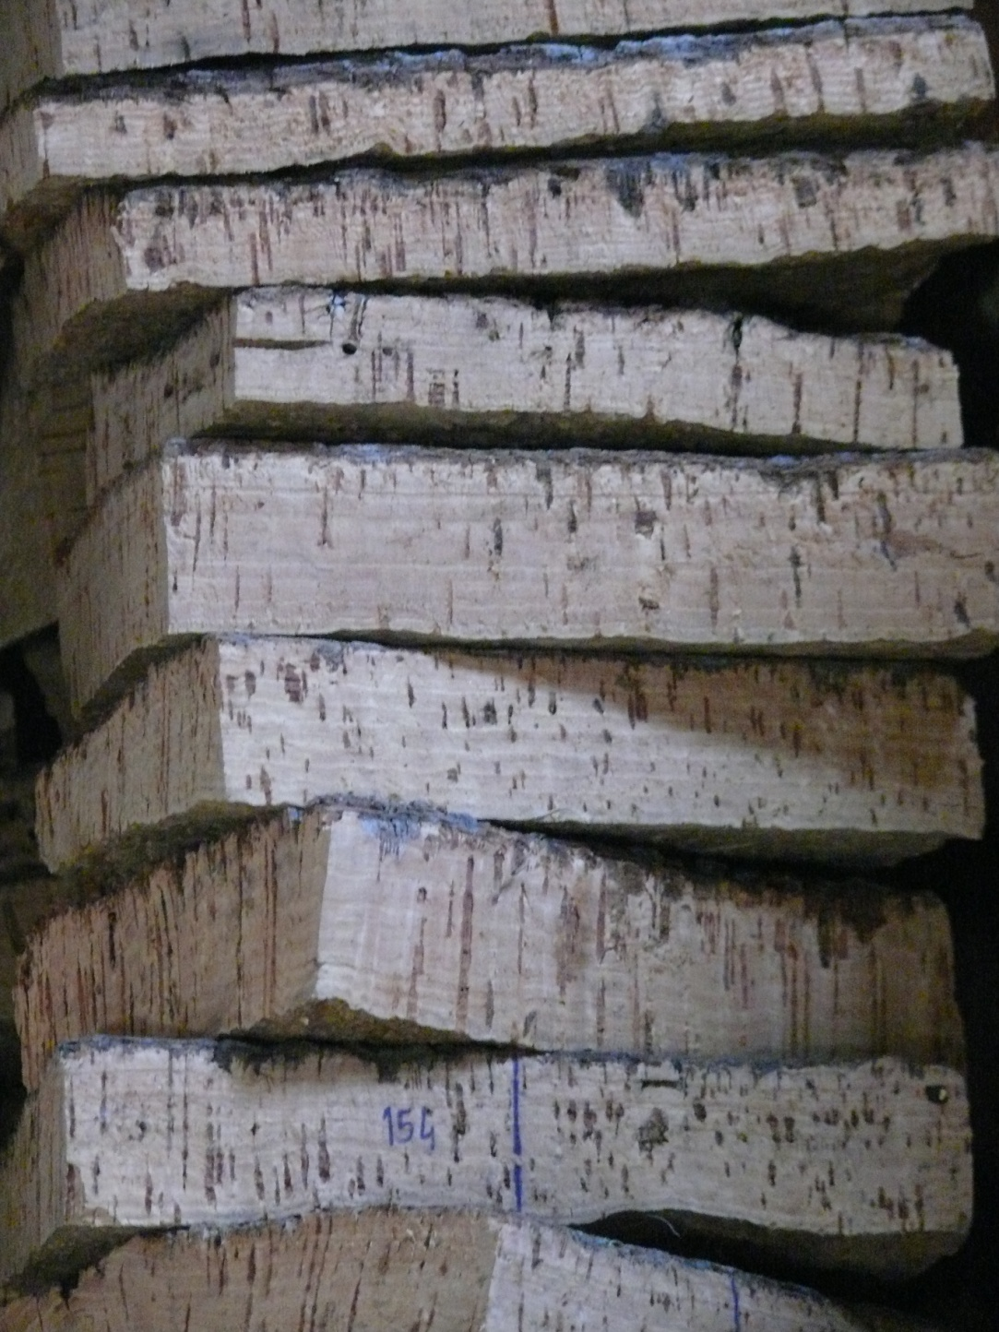
Fit for 55
The Communication on ‘Stepping up Europe’s 2030 climate ambition” has set the target of 55% GHG emissions reduction by 2030”.
To operationalise the Green Deal’s increased climate ambitions, the Commission adopted of the ‘Fit for 55’ package (14 July 2021)
Focuses on the capacity of forests to act as a “carbon sink” but pays little to no attention to carbon storage and substitution

Slide 24
Fit for 55
Fit for 55 main legislative proposals:
Revision of the regulation on the inclusion of GHG emissions and removals in Land Use, Land Use Change and Forestry (LULUCF): EU target for carbon removals + plant 3bn trees + role of EU Forest Strategy for 2030 (Forests expected to compensate for other sectors’ emissions)
Amendment to the Renewable Energy Directive (RED): 40% of our energy to be renewable + sustainability criteria for bioenergy
Proposal for a Carbon Border Adjustment Mechanism (CBAM): sets carbon price on imports to make sure EU imports contribute to global emissions reduction

Slide 25
Forest Strategy for 2030
Problem:
Imbalance: focuses on forest preservation, no place for forest use
Subsidiarity is hardly respected (stakeholders and Members States were nearly ignored)
Consistency: the strategy will not support other EU strategies and legislations (e.g. bioeconomy strategy, renewable energy directive), both inside and outside the Green Deal
The strategy needs clarifications before considering implementation, as the objective for EU forests and forestry is not clearly and consistently defined
‘Quality’ of forests is unlikely to increase

Slide 26
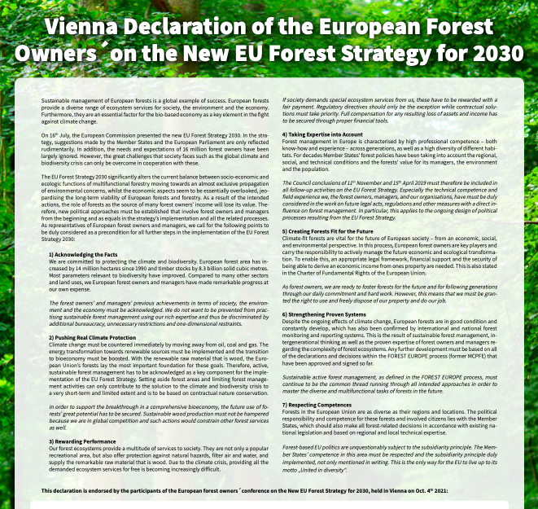
Forest Strategy for 2030
actions
Support of the “EU forest owners Conference” and the Vienna Declaration of the European Forest Owners on the New EU Forest Strategy for 2030 (4/10/2021)
Supporting the Council Conclusions
Several meetings with cabinet and share of concrete comments to leaked proposal
Several joint press releases
Meeting with commissioner Wojciechowski
#WelcomeToMyForest campaign
...

Slide 27
Forests: looking ahead
Participation to International conference Ljubljana on property rights and private forests (14/12/2021)
Roundtable with VP F. Timmermans and forest actors (02/2021)
Organisation with like-minded stakeholders of a postcard campaign: to show VP F. Timmermans foresters and their families in their forests
Developing guidelines on Closer-to-nature forestry and biodiversity-friendly afforestation and reforestation and tree planting, and definition of Old-Growth forests (WG forest & Nature)
Follow-up on Commission proposal for a deforestation-free products: avoid imported deforestation
Follow-up on LULUCF, CBAM and REDIII adoption
Development of a carbon farming approach

Slide 28
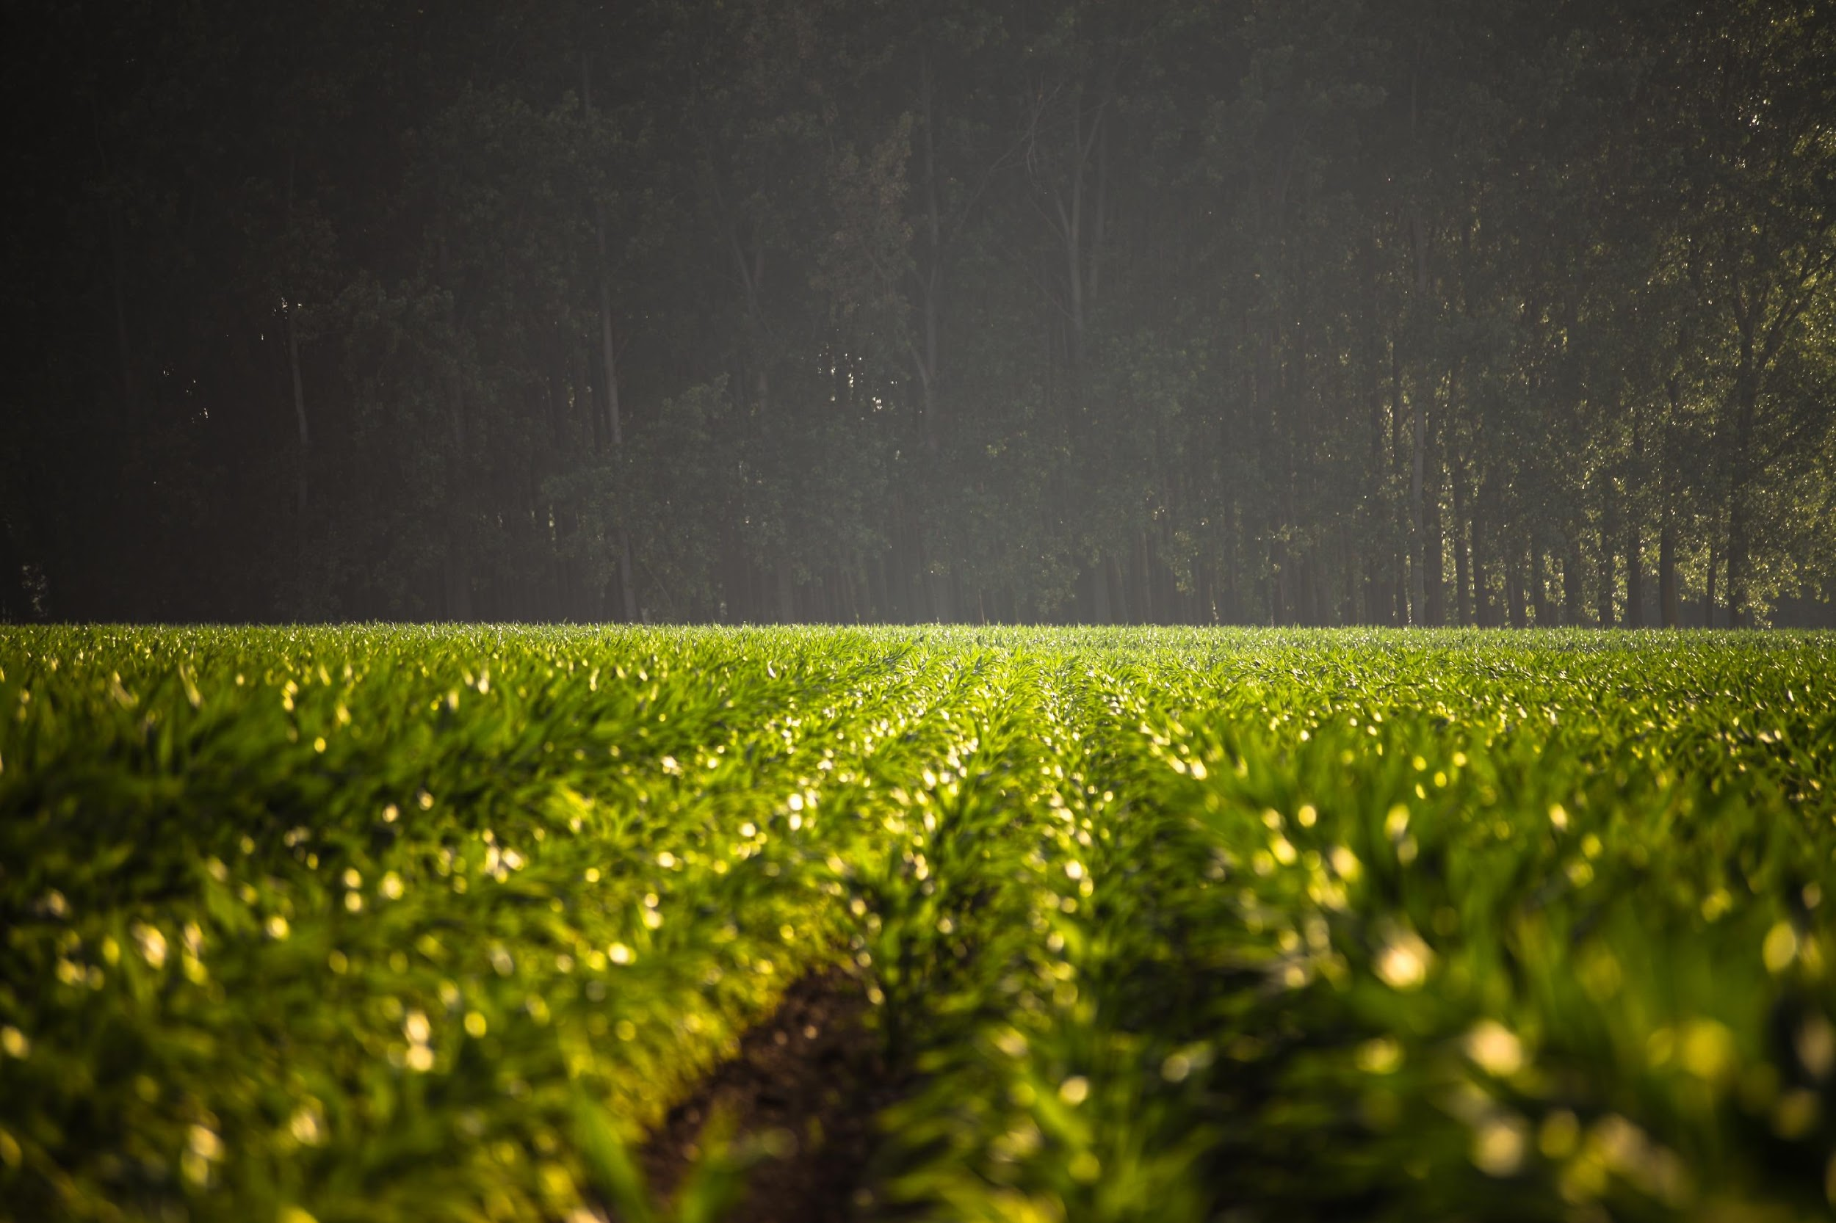
GENERAL ASSEMBLY
ELO publications and actions

Slide 29
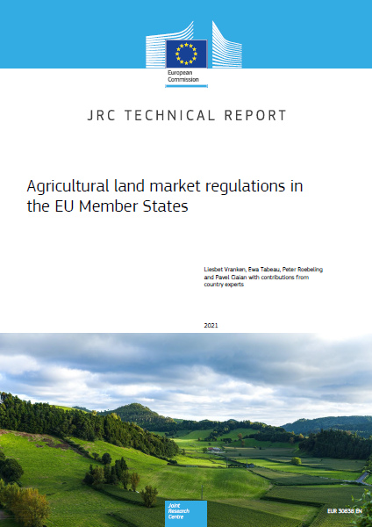
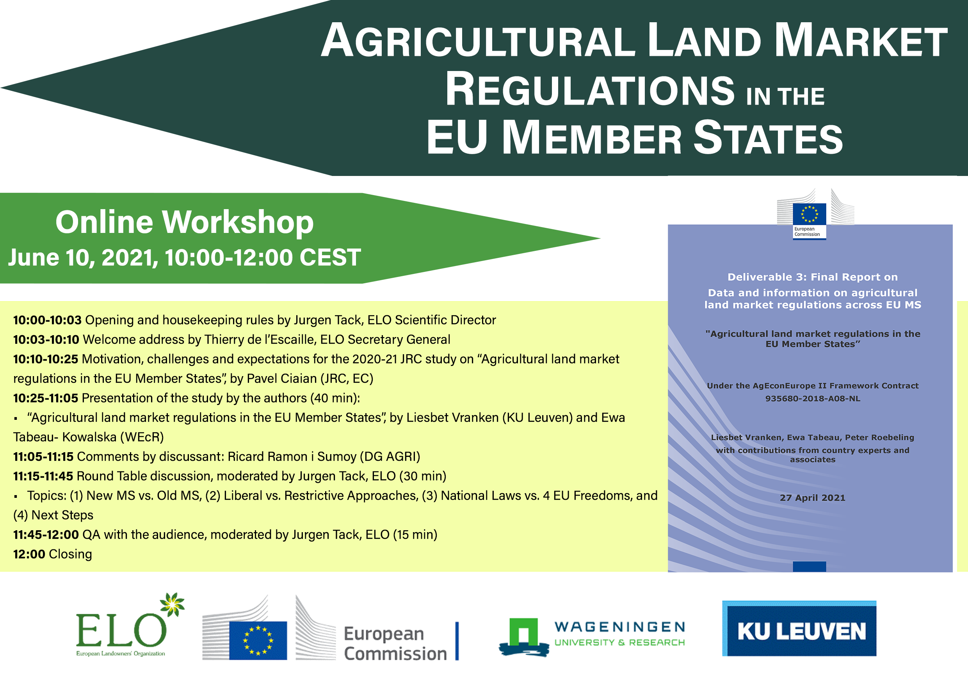
Land Access and Markets
GENERAL ASSEMBLY
The dangerous trend on false debate on land theft and land grabbing continues in Europe.
On October 29 ELO took part in the DG FISMA workshop on “Agricultural land market regulations in the EU Member States”, following the publication of the JRC report.
DG FISMA will order a follow up report on these issues to be used during the discussion on the Long-term vision for the EU’s rural areas
ELO underlined that one issue is whether the national regulations are compatible with the free movement of capital.
Another is whether the CAP itself does not to acknowledge an explicit multi-functionality. Often land regulation just seems to be a reflection of the paucity of the rural economy. Those concerns were also discussed during ELO own workshop in June.

Slide 30
Large Carnivore Platform
GENERAL ASSEMBLY
The ELO is a founding member of the large carnivore platform
We promote sustainable management of these creatures, especially with regards to livestock management and hunting
Working together with 8 other organisations and the European Commission for better regulations

Slide 31
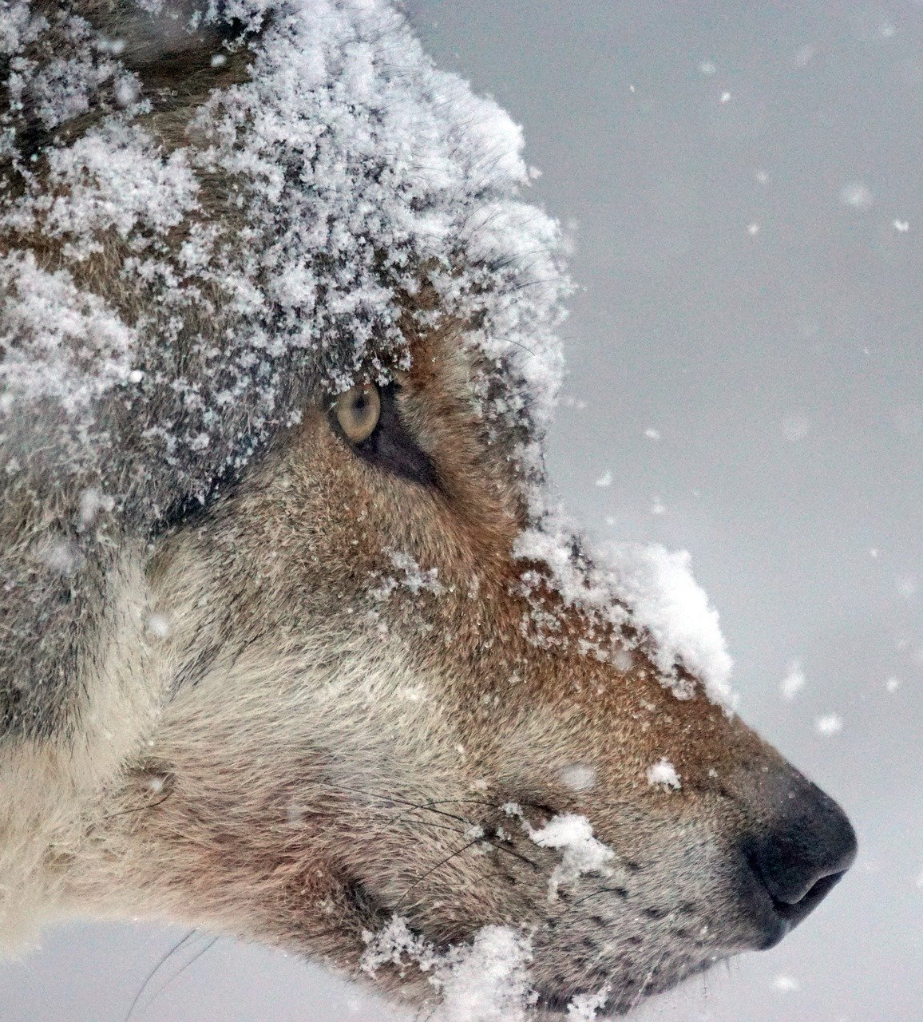
Wolf study
GENERAL ASSEMBLY
ELO published in 2020 a fully illustrated version of the report it prepared for the European Commission in 2019. The report supports ELO and its member organisations when advocating for measures in areas where socio-economic problems due to the presence of the wolf are rising.
Based on the review and the documents of the EC’s EU Large Carnivore Platform combined with the feedback from its membership, ELO made a number of recommendations in order to tackle some of the concerns of Europe’s rural inhabitants towards the increasing growth of wolf population in Europe’s rural areas.
This report was made as with the financial support of DG Environment European Commission (negotiated procedure ENV.D3/ETU/2018/5458098).

Slide 32
Small wildlife study
GENERAL ASSEMBLY
In cooperation with Francois Sommer Foundation, AGPB and OFB
Objective: role of private landowners, farmers and hunters in the conservation of small wildlife of meadows and fields
Policy recommendations underlining the need to give incentives to private landowners on top of existing instruments for farmers
The need for private landowners, farmers and hunters to coordinate their actions in the field

Slide 33
Private Land Conservation Project
LIFE LIFE - Land Is For Ever
GENERAL ASSEMBLY
The ELO is leading a project to promote
private conservation in Europe
Aiming a variety of tools to support all private owners in conservation actions on their land
Equal access to funding as terrain-managing NGOs currently have
One of the most important projects the ELO has ever engaged in

Slide 34
Private Land Conservation Project
Follow-up project:
Life ENPLC - European Networks
for Private Land Conservation
GENERAL ASSEMBLY
Coordinated by ELO and Eurosite
= “Conservation Landowners Coalition”
Set up of the “European private land conservation (PLC) secretariat”
Supporting the networking among PLC organisations and individuals
Expanding the use of PLC tools with emphasis on conservation easements
Improving the financial incentives and funding for PLC in Europe

Slide 35
GENERAL ASSEMBLY
Wildlife Estates
Label

Slide 36
GENERAL ASSEMBLY

Slide 37
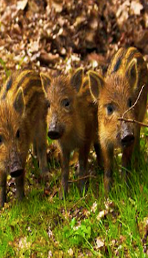
Wildlife Estates Plenary Session: Wolfsburg 2020
GENERAL ASSEMBLY
WE members met in Wolfsburg (Germany) in September for their annual meeting
Presentation of updated data on the estates
Now over 2.000.000 verified hectares
Future methodology improvements regarding the Green Deal

Slide 38
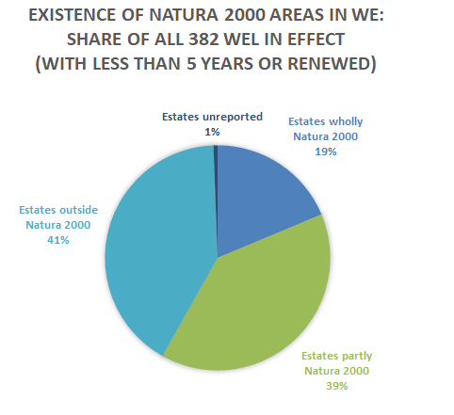
Natura 2000 coverage
of Wildlife Estates
GENERAL ASSEMBLY
60% fall partly or wholly in Natura 2000
724.500 ha (≈ 41% of the total area of WE) fall under the Natura 2000 Network of which 377.800 ha (≈ 22% of the total area of WE) are WE which are wholly Natura 2000.

Slide 39
Wildlife Estates:
Expected growth
GENERAL ASSEMBLY
In the coming 2-4 years,
ELO predicts
2 to 3 million hectares
will receive WE certification

Slide 40
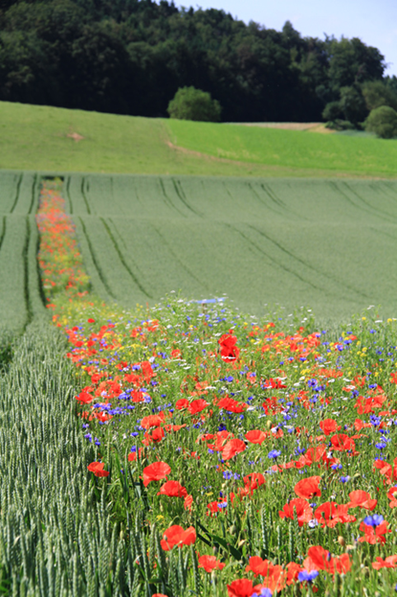
AgriLife
GENERAL ASSEMBLY

Slide 41
AgriLife
GENERAL ASSEMBLY
The first label that places, encourages and rewards the farmer at the center of biodiversity restauration, while creating a process and an alliance between all stakeholders.
A reference for decision makers in order to anticipate problems and inspire reforms
Notes:
. Common ambition
. Common vision & Goals
. Solid, smart & reconciled policies & Criteria
. High level achievements in Agro- Biodiversity
. An alliance through a powerful and respected network
. Where farmers are the rewarded engine
. An economically viable agro-agriculture

Slide 42
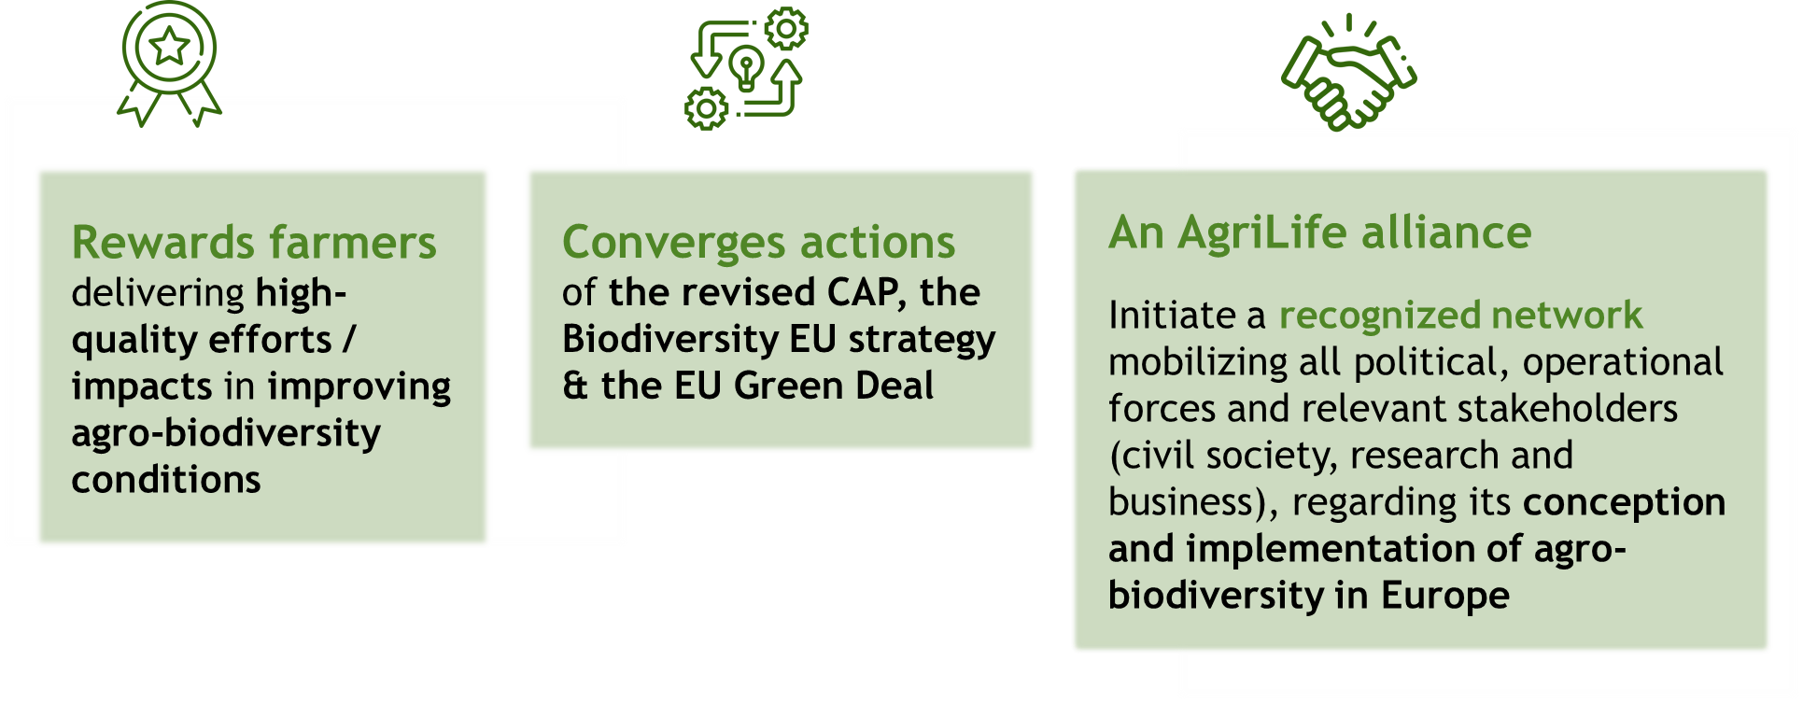
AgriLife
Its ambition
GENERAL ASSEMBLY

Slide 43
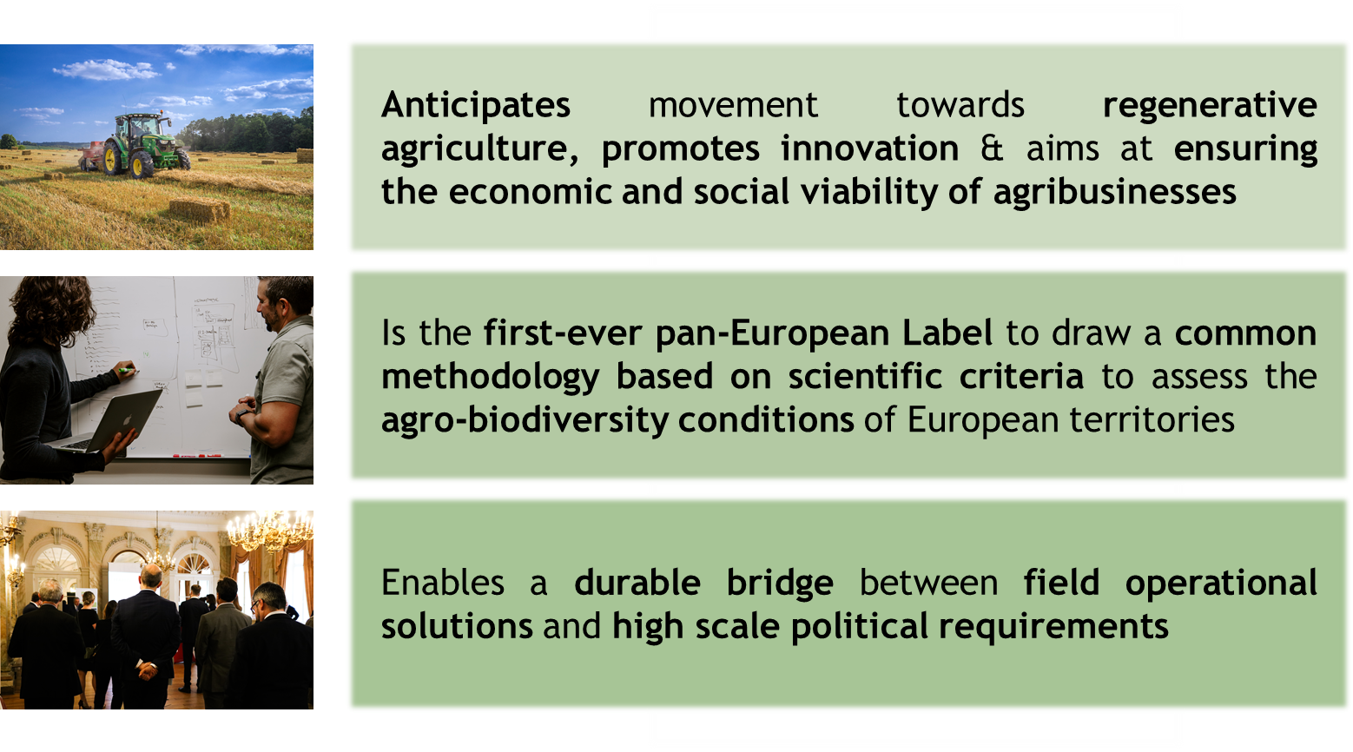
AgriLife
GENERAL ASSEMBLY

Slide 44
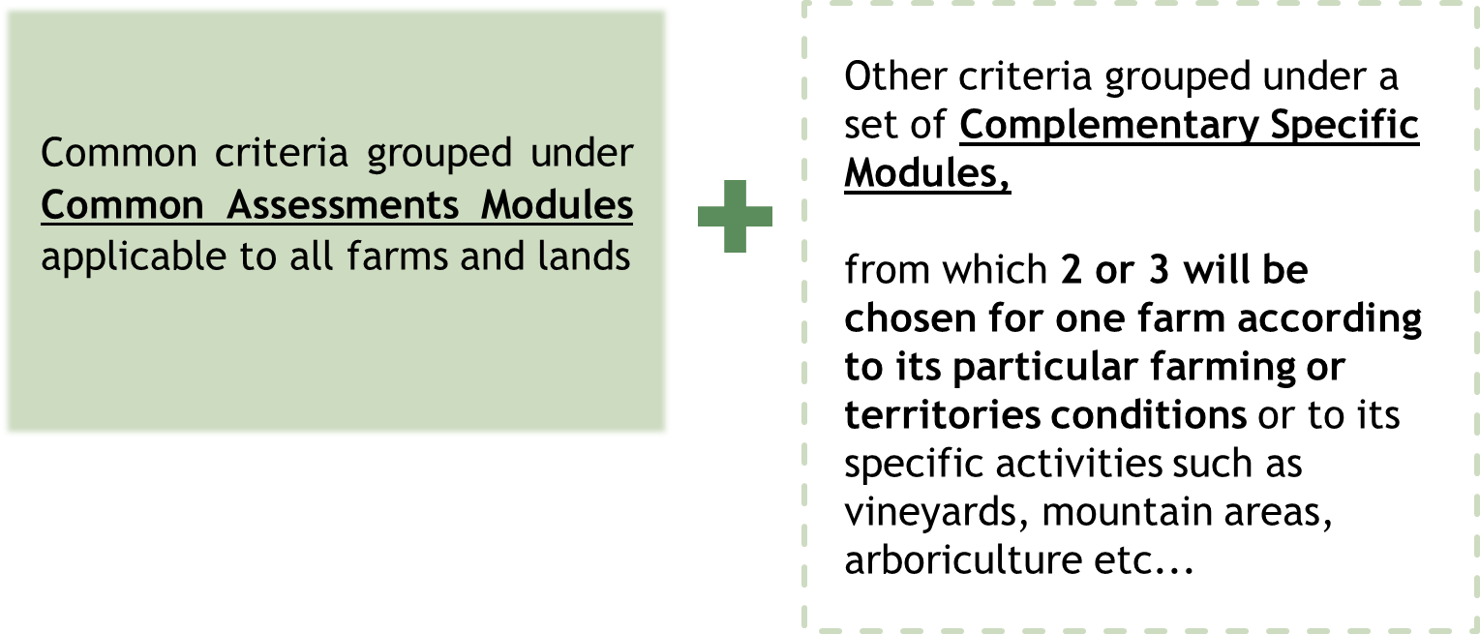
AgriLife
The certification criteria composition
GENERAL ASSEMBLY

Slide 45
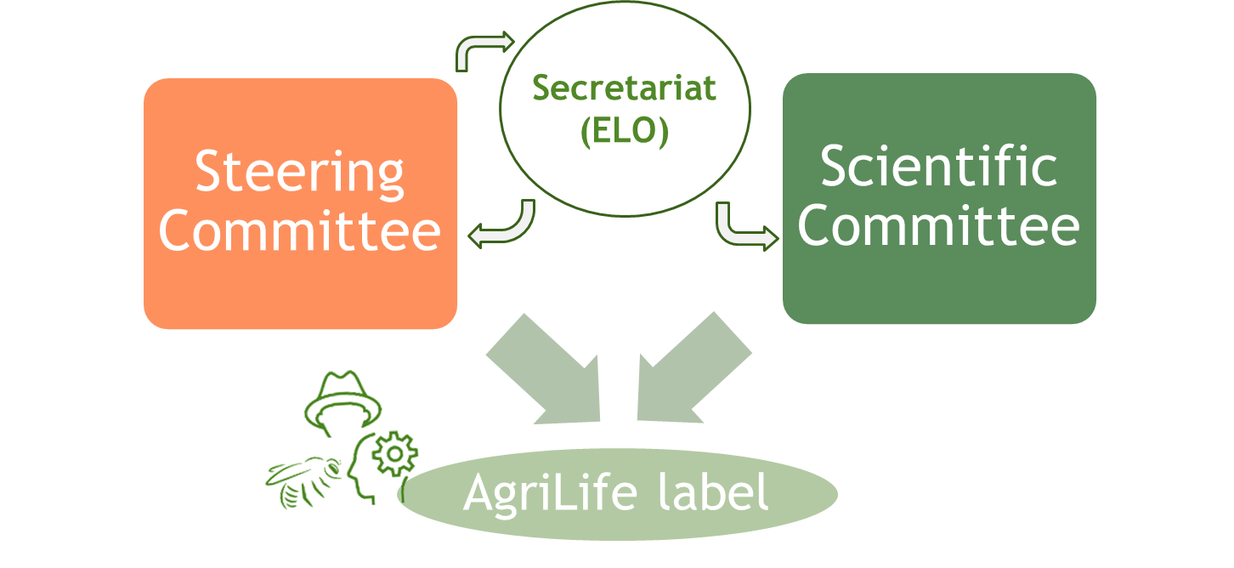
AgriLife
The structure of Governance body
GENERAL ASSEMBLY

Slide 46
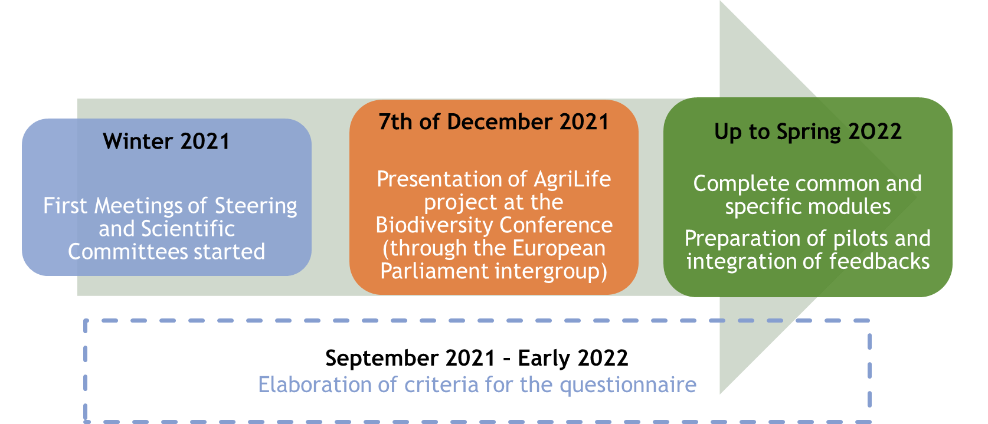
AgriLife
Timeline
GENERAL ASSEMBLY

Slide 47
GENERAL ASSEMBLY
Events

Slide 48
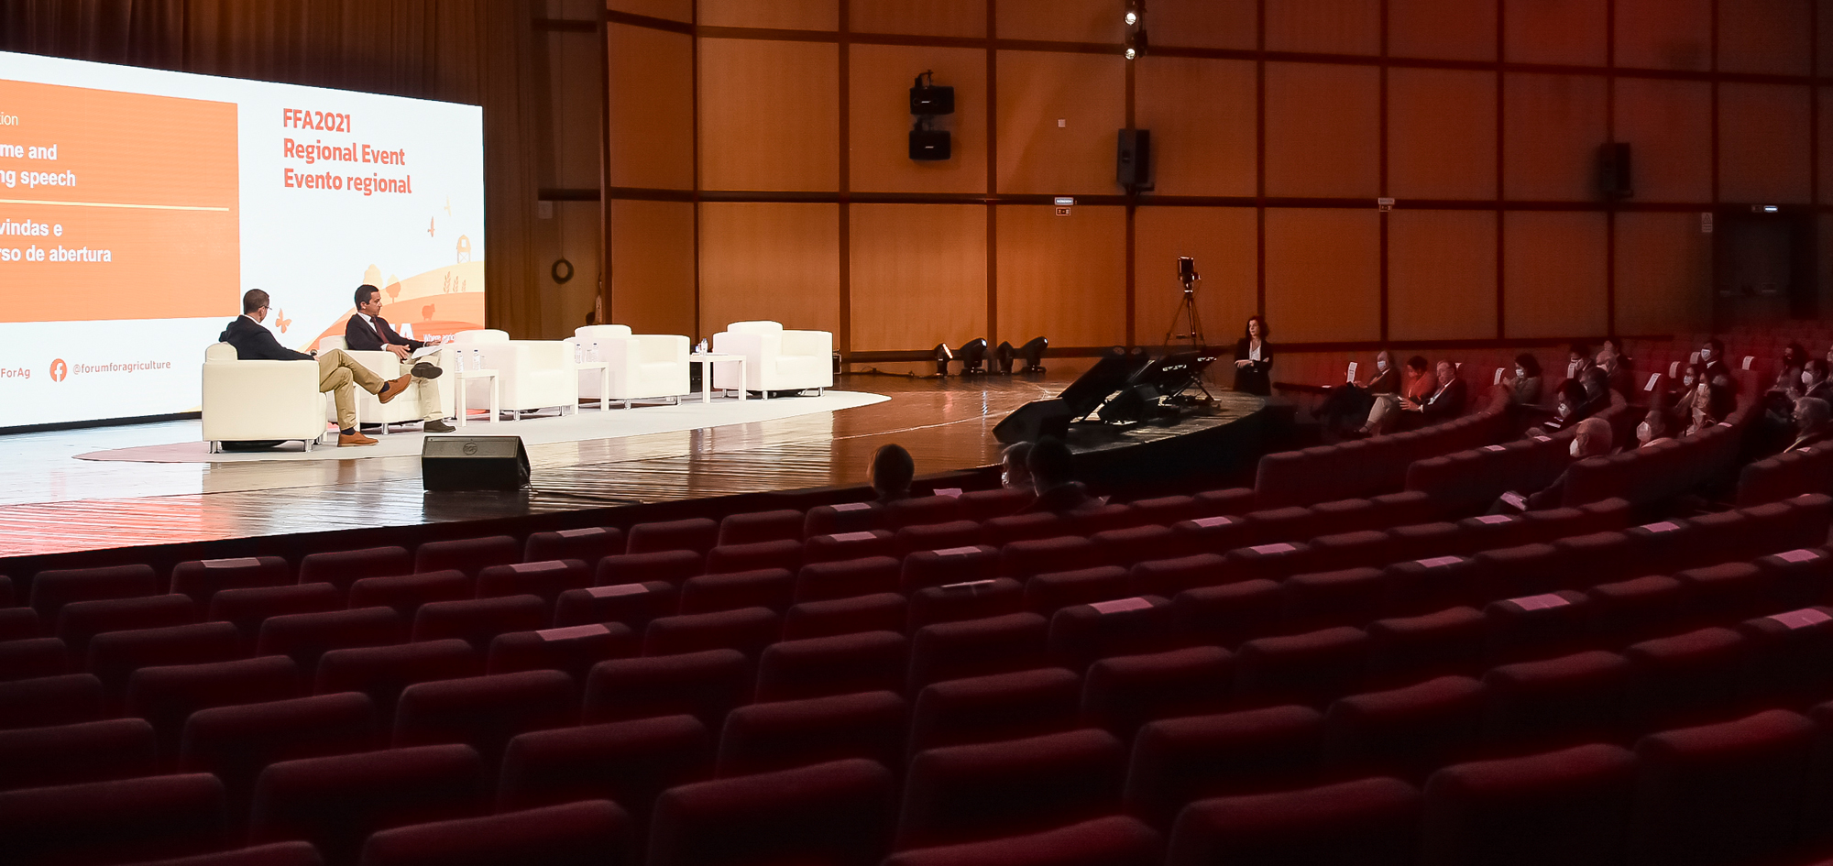
GENERAL ASSEMBLY
2021 was a launch of a full ‘Month of March’ program.
The 1st edition of the Regional Event was held in Portugal in person & online.
The 2nd edition will take place tomorrow, here in Paris & online.
Save the date: March 15, 2022 The Square, Brussels
Bi-monthly podcast is growing

Slide 49
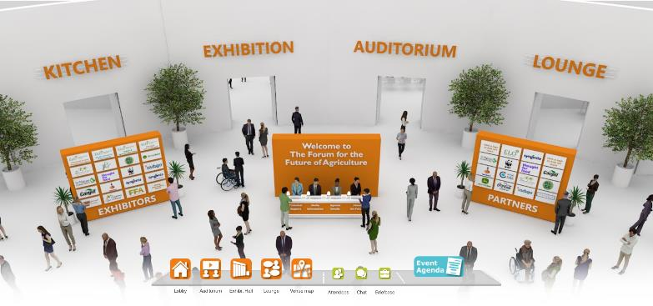
GENERAL ASSEMBLY
In 2021, the Forum moved online for certain events

Slide 50
GENERAL ASSEMBLY
New logo unveiled recently
New & Renewed partnerships & events
A bold annual work program

Slide 51
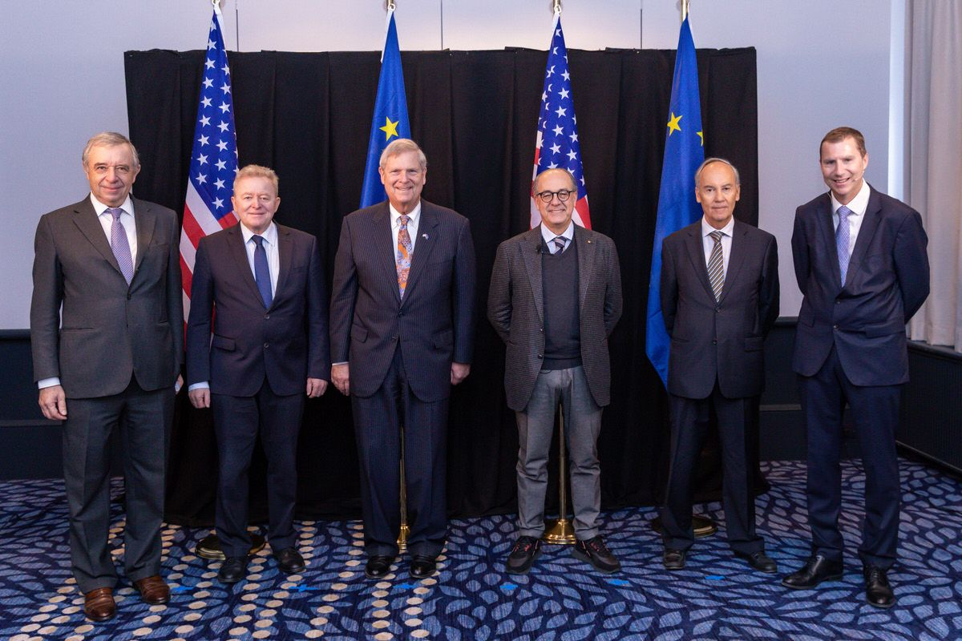
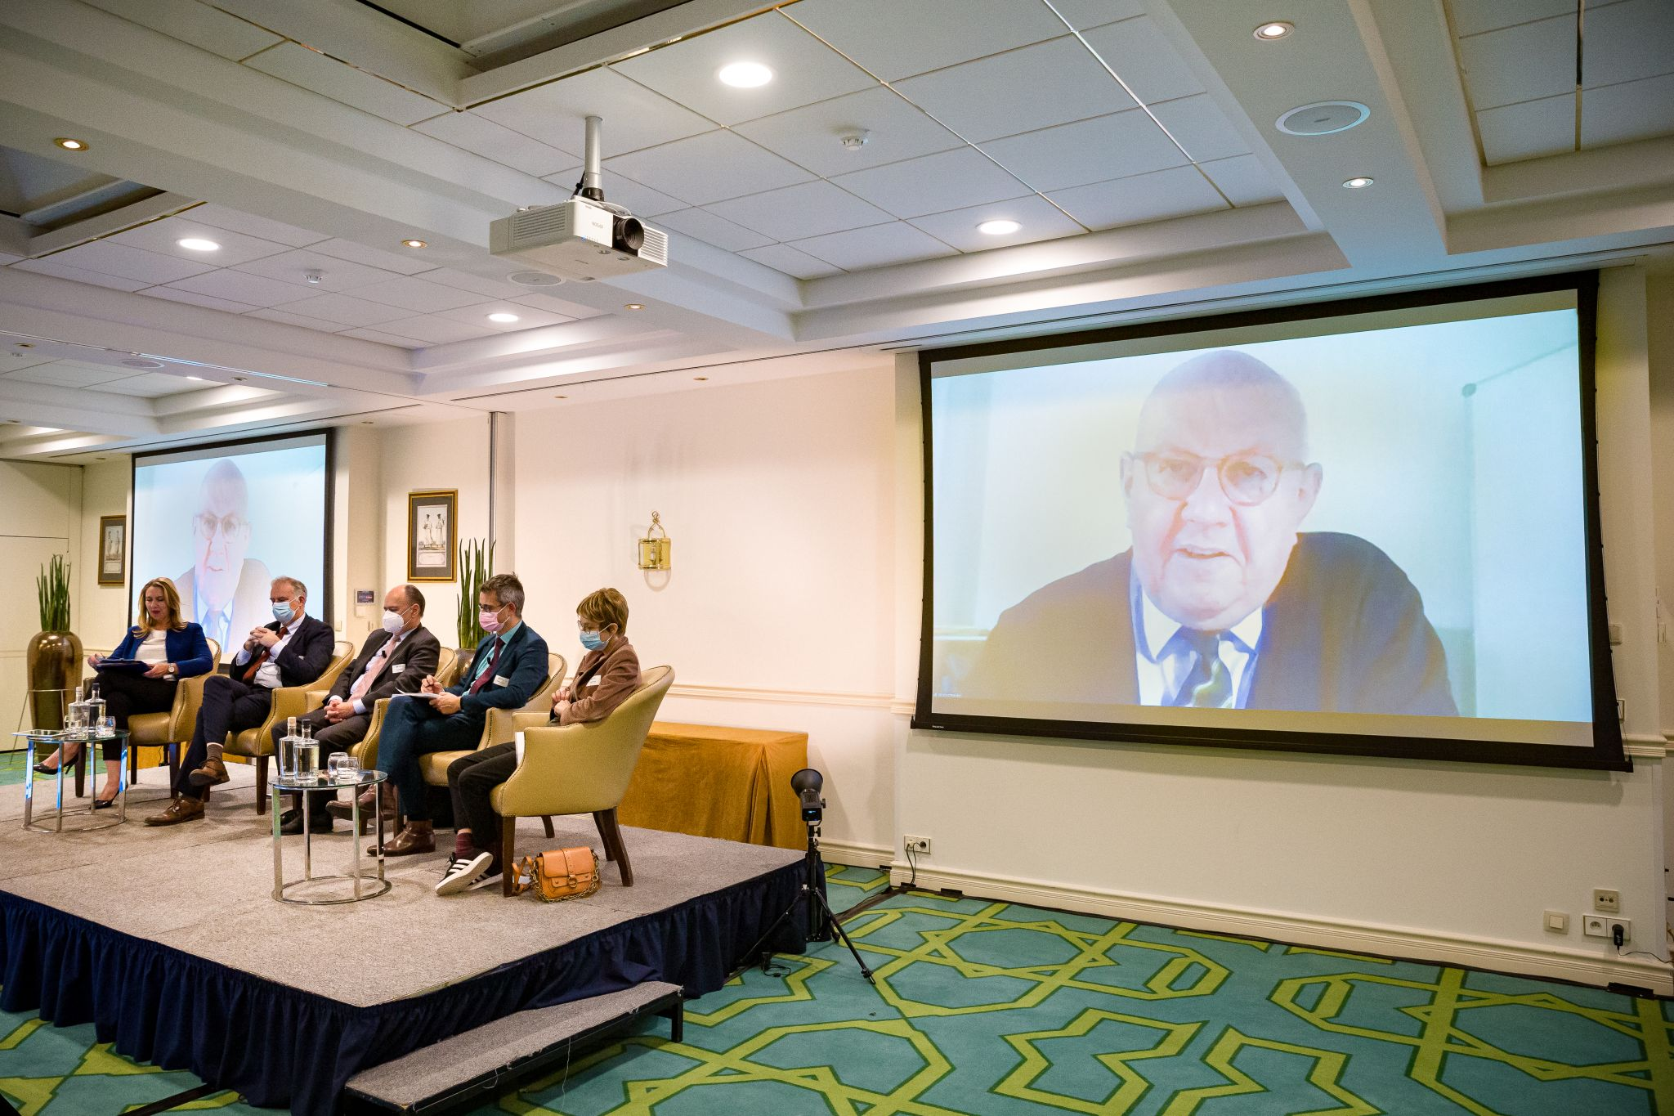
New and exciting events
UN Food System Summit Dialogue
EU-US Collaboration
EU Green Deal Panel

Slide 52
Friends of the Countryside
GENERAL ASSEMBLY
The private support network of the ELO
450+ private land managers and entrepreneurs
Successful 24th GA in Cordoba with 250 participants
www.friendsofthecountryside.org
FCS Jubilee 25th General Assembly in Evora will take place from Thursday June 9 to Sunday June 12, 2022

Slide 53
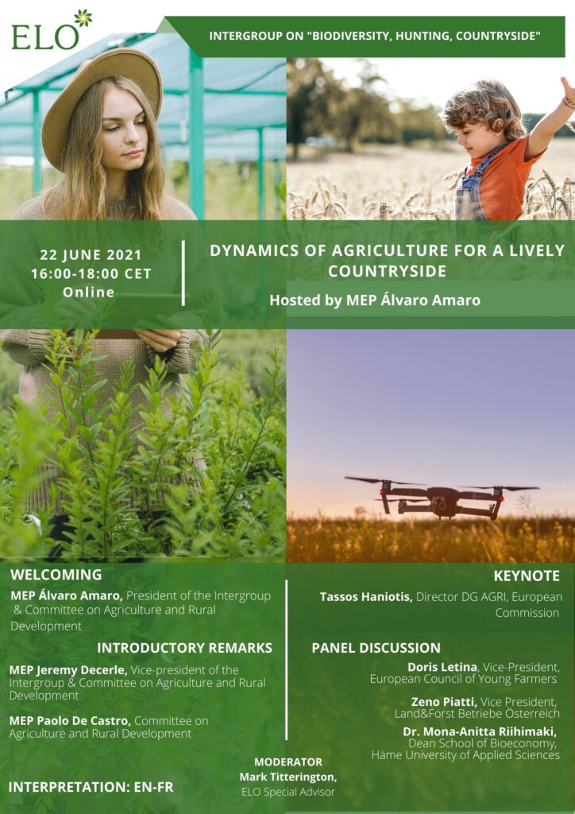
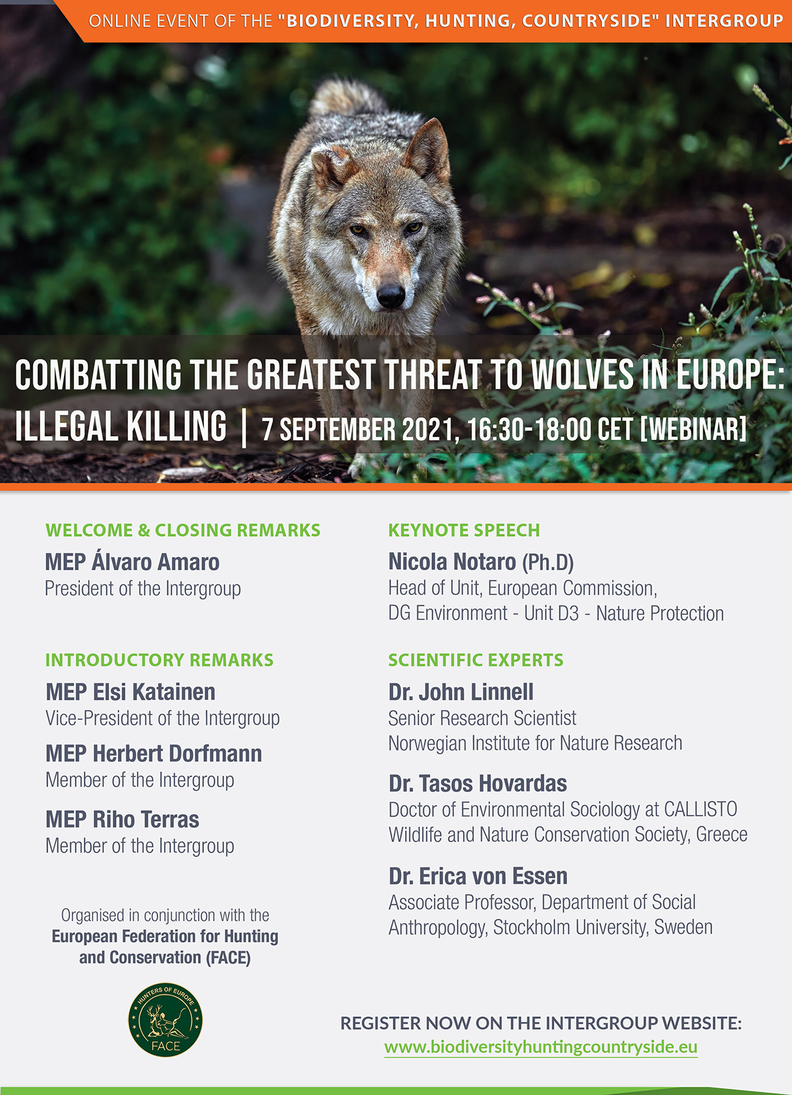
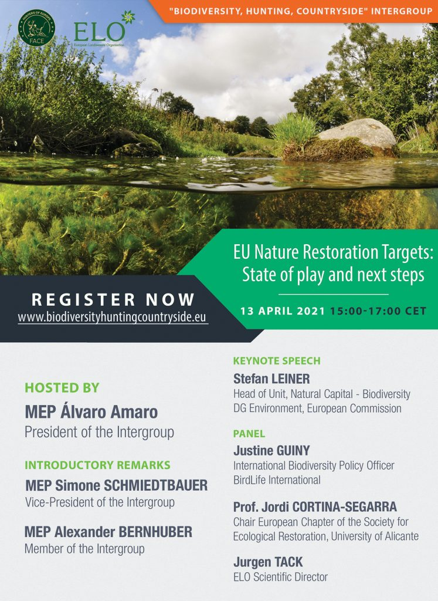
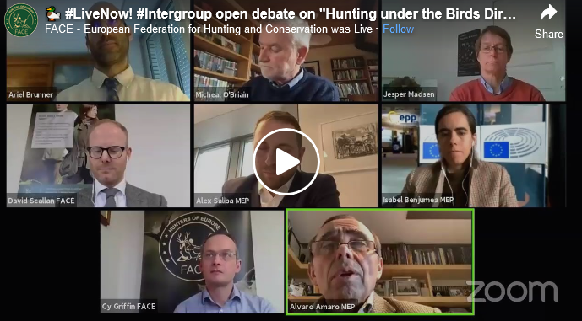
European Parliament “Biodiversity, Hunting, Countryside” Intergroup
GENERAL ASSEMBLY
A full year 2021 in hybrid :
“Combatting the greatest threat to wolves in Europe: Illegal killing” (Sept.)
Dynamic of Agriculture for a Lively Countryside (June)
EU Nature Restoration Targets: State of play and next steps (April)
Hunting under the Birds Directive: an open debate on the state of play (Feb)

Slide 54
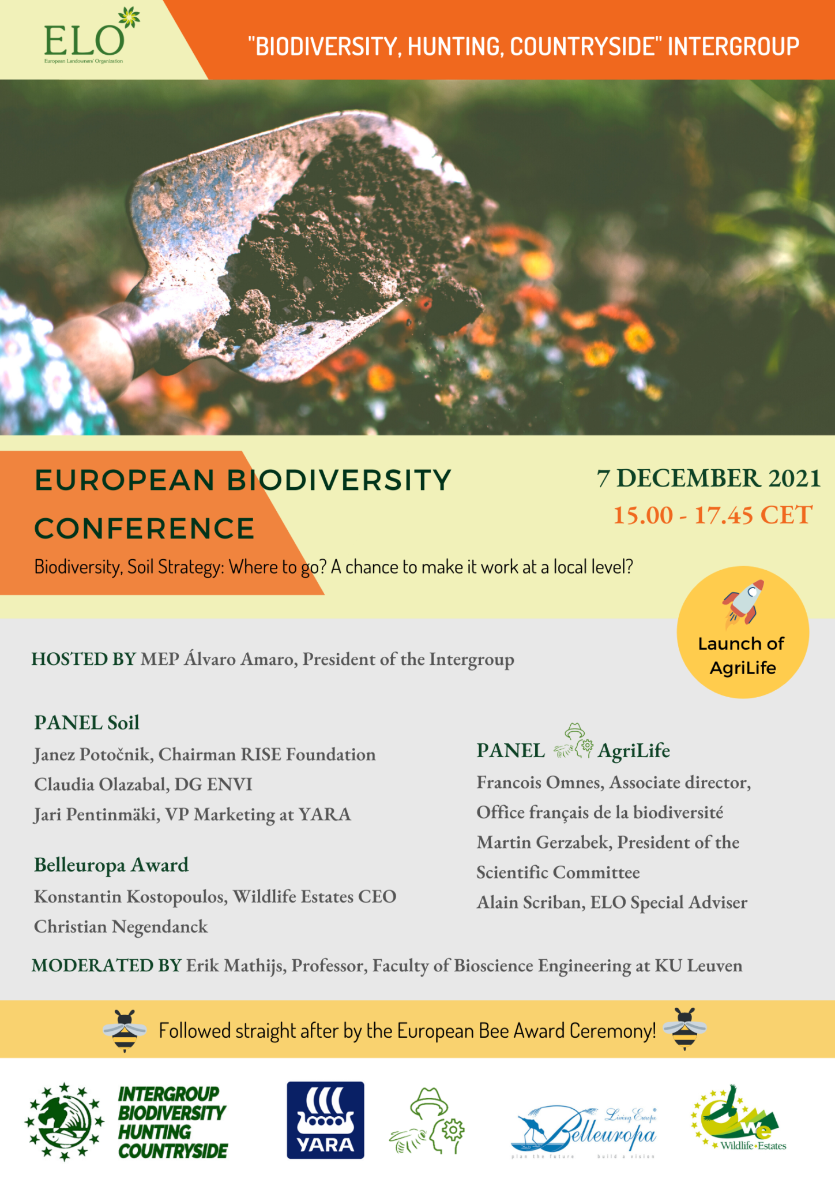
European Parliament “Biodiversity, Hunting, Countryside” Intergroup
GENERAL ASSEMBLY
European Biodiversity Conference
& European Bee Award
REGISTRATIONS ARE OPEN !
YOU CAN JOIN IN PERSON or ONLINE

Slide 55
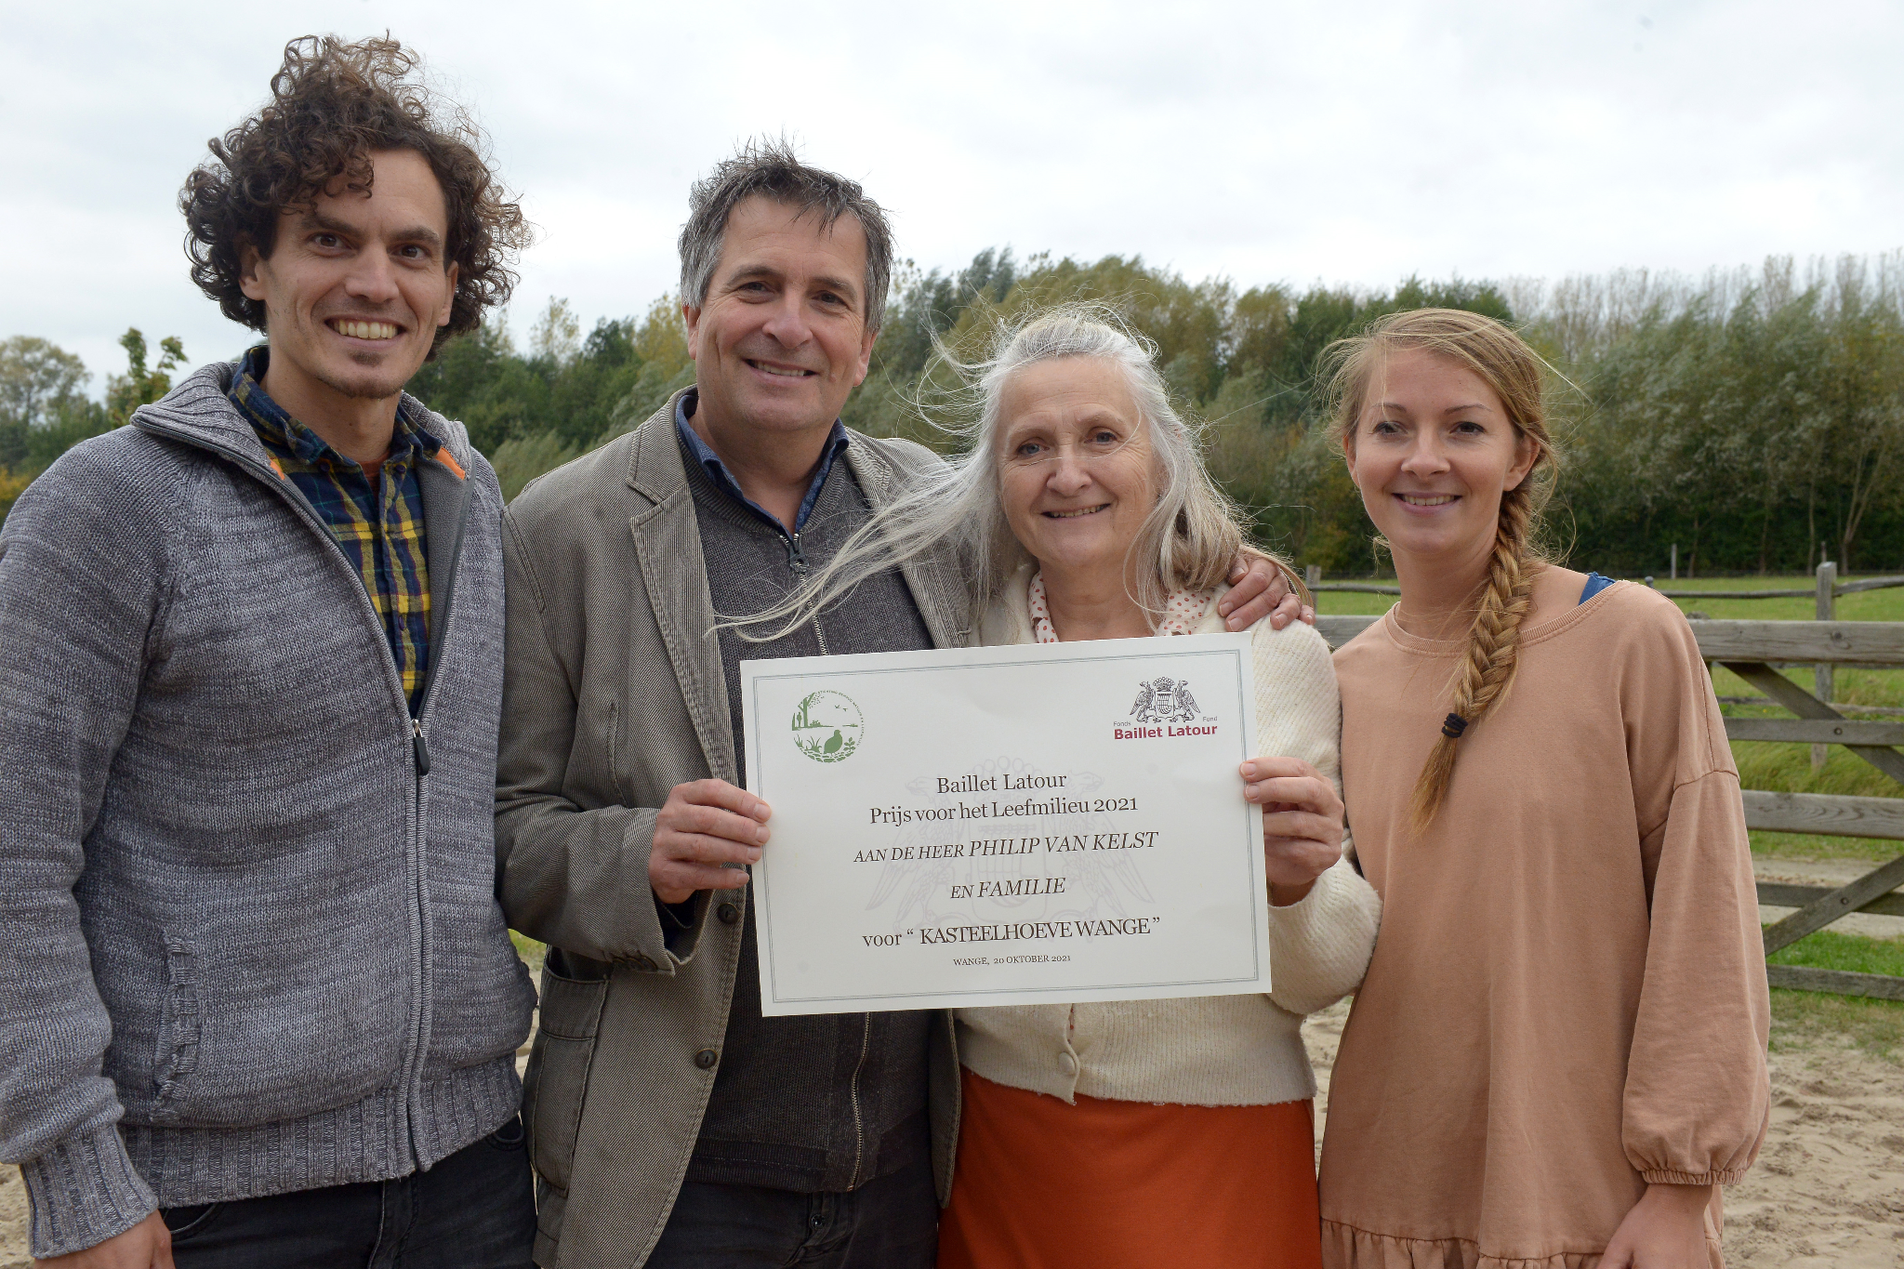
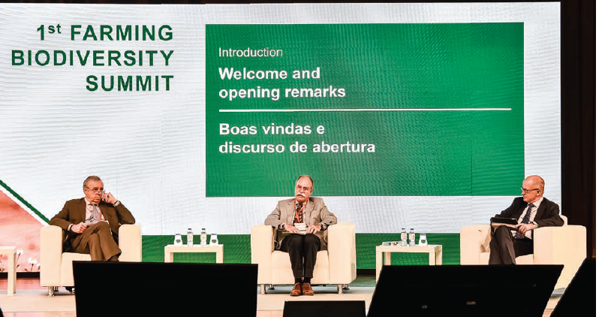
Further Annual Events
GENERAL ASSEMBLY
Annual Innovation Conference
Tree of the Year Ceremony
Regular High-Level Dinners
2 Regional FFA’s outside Brussels
2 General Assemblies per year
All events currently under scrutiny due to Corona

Slide 56
GENERAL ASSEMBLY
Awards

Slide 57
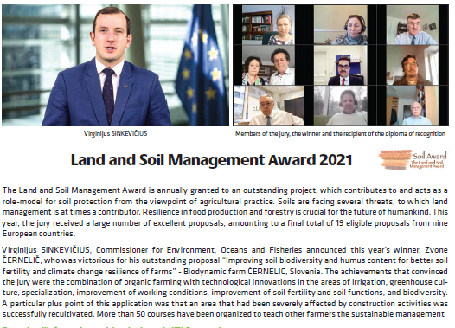
Soil Award
GENERAL ASSEMBLY
YOU CAN APPLY BY JANUARY 15 2022!
This

Slide 58
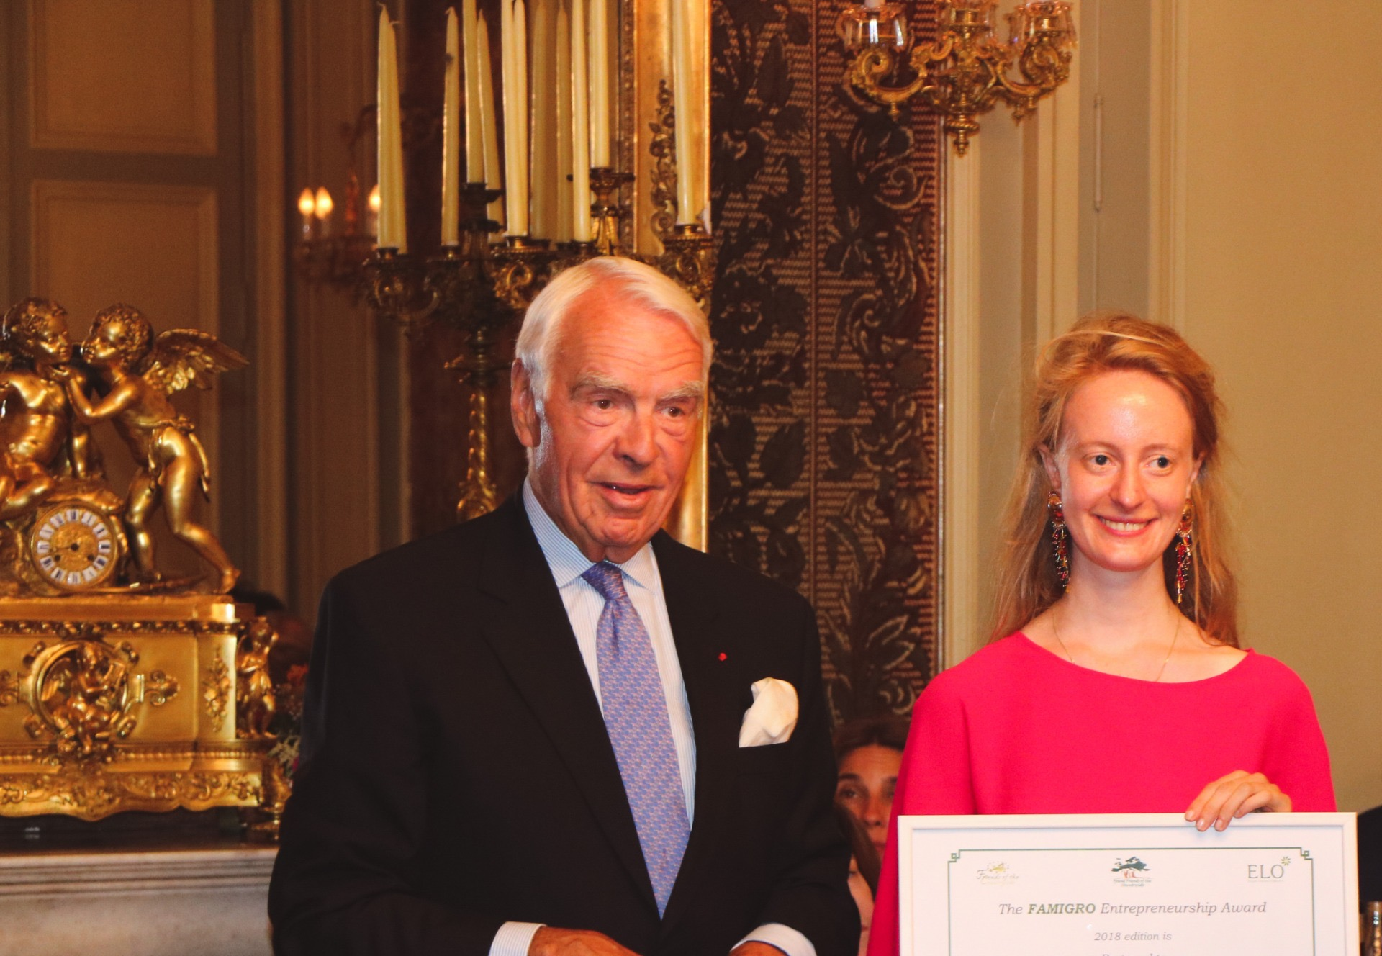
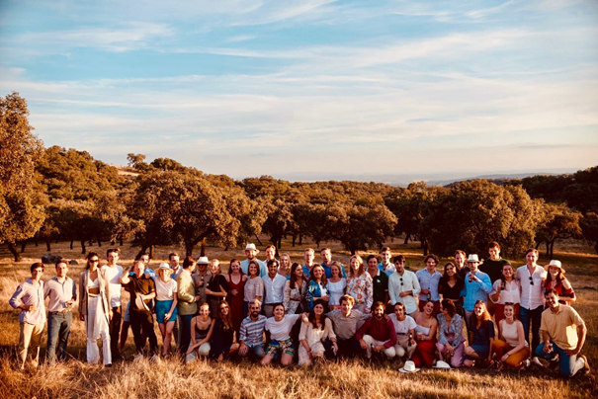
Famigro Award
GENERAL ASSEMBLY
Created by Karl Grotenfelt in 2013
Awarded to young entrepreneurs (18-40) who begin a new, innovative concept in the countryside
Aims to support rural life, the environment, and social responsibility
Famigro winner in 2021: Alfonso CHICO DE GUZMÁN & Team for “La Junquera Regenerative Farm and Entrepreneurship HUB”
More information and forms on ELO and YFCS websites www.yfcs.eu

Slide 59
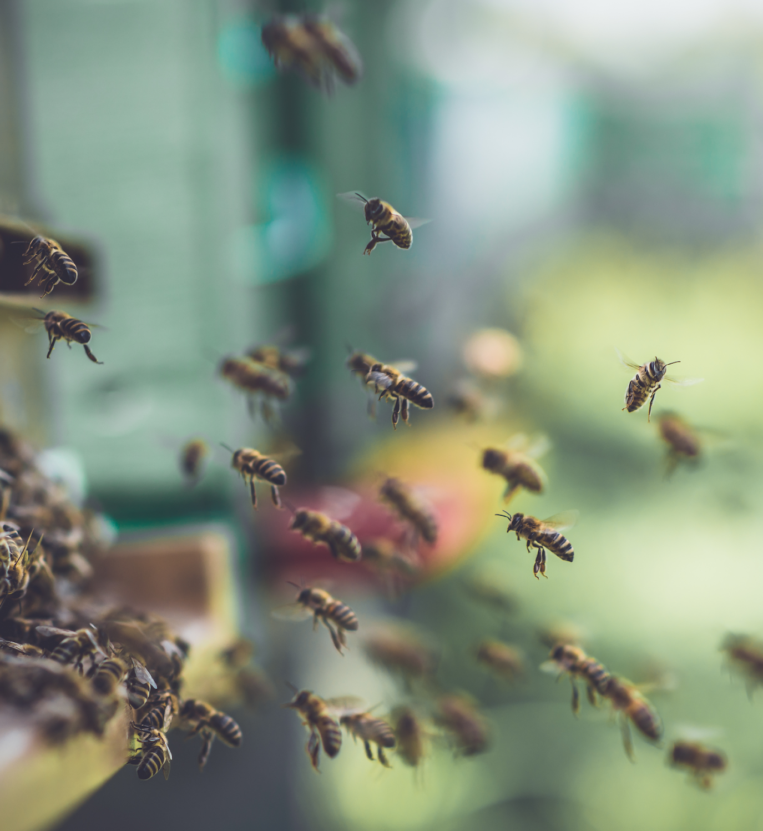
European Bee Award
GENERAL ASSEMBLY
With the support of
Created to demonstrate benefits of land management for biodiversity
Excellent communication tool
High level jury
Great communication, networking event in the European Parliament

Slide 60
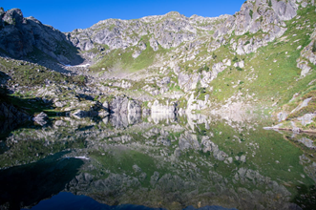
BellEuropa Award
GENERAL ASSEMBLY
The BellEuropa Award honours a Wildlife Estate Label territory that has realized an important step forward for the benefit of biodiversity
2019 winner was “Valbelviso” in the alpine territory of Italy. The estate covers 12.000 hectares with many valuable and endangered species, both botanic and faunistic, thanks to the valuable natural habitats
Open to all Wildlife Estate label holders
NEXT CEREMONY: December 7 2021

Slide 61
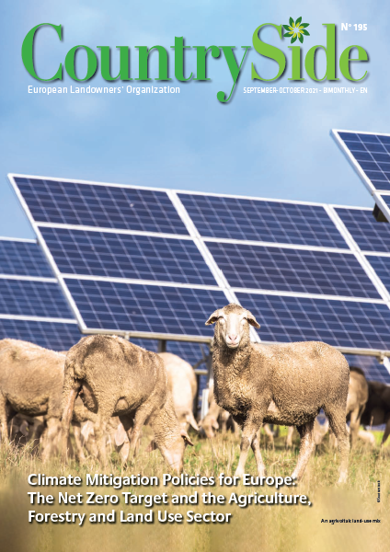
Communication Tools
GENERAL ASSEMBLY

Slide 62
GENERAL ASSEMBLY
Thank you for your attention

